Slide 1

QUIZZO
Made By
Harjot Singh & Jaspreet Singh
(2110993784 & 2110993802)

Slide 2
#CONTENTS
About the Game
Modules used
Screenshots of the game

Slide 3
#ABOUT THE GAME
Quizzo is a multiple choice quiz game that consists of a total number of 20 questions.
The user is asked to attempt 10 questions at once.
The first page is for log in/sign up, a new user is asked to sign up and create his/her username and password for later logins.
After login, there are 2 buttons of start and instructions.
After attempting 10 questions the result will be shown at the end of the game.

Slide 4
#MODULES USED
Random
Mysql.connector
Pillow
Tkinter

Slide 5
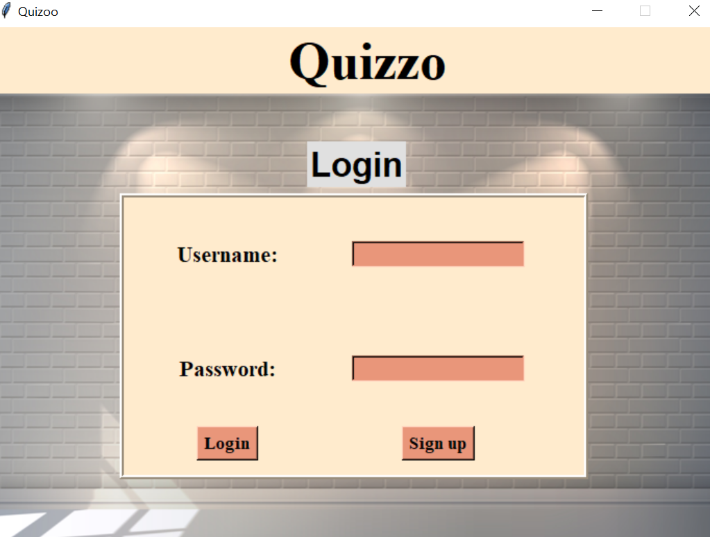
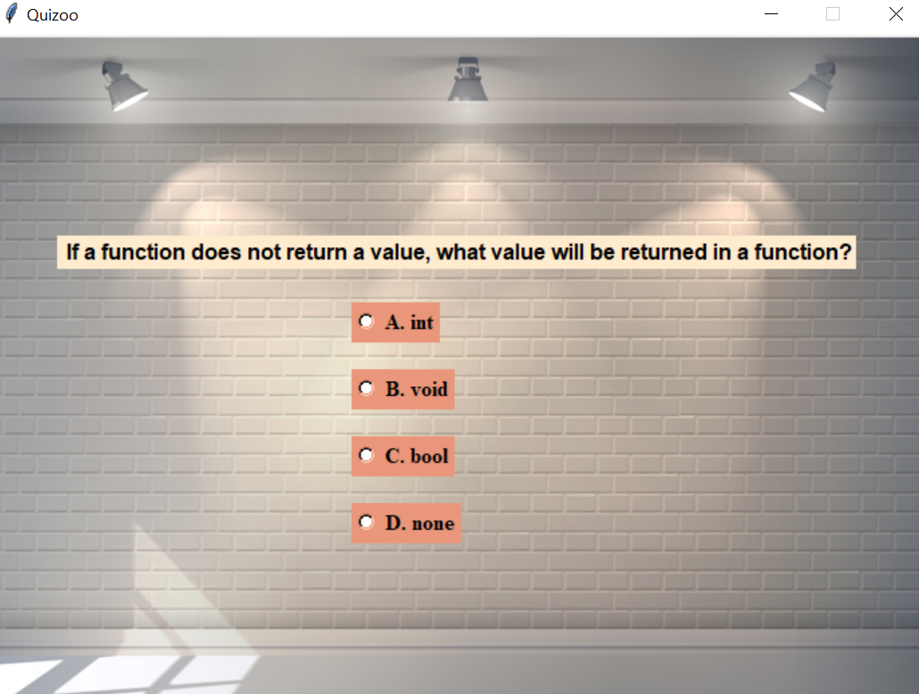
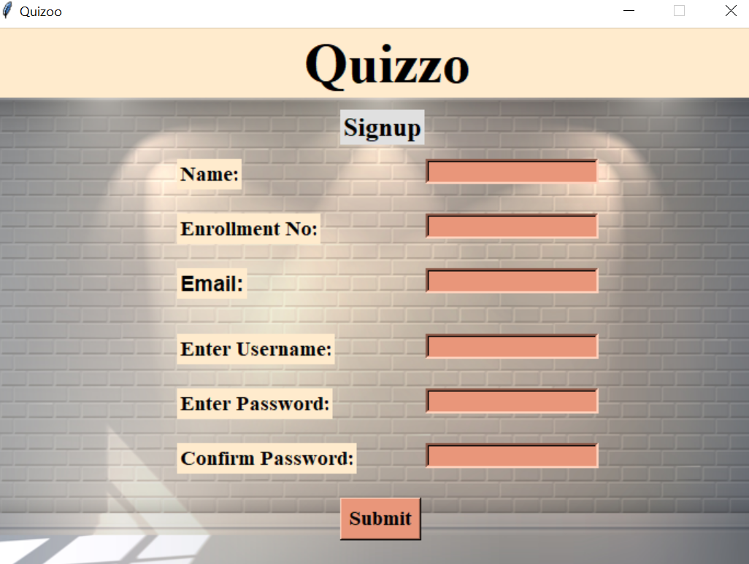
#Snapshots of Quizzo:

Slide 6


